Slide 1

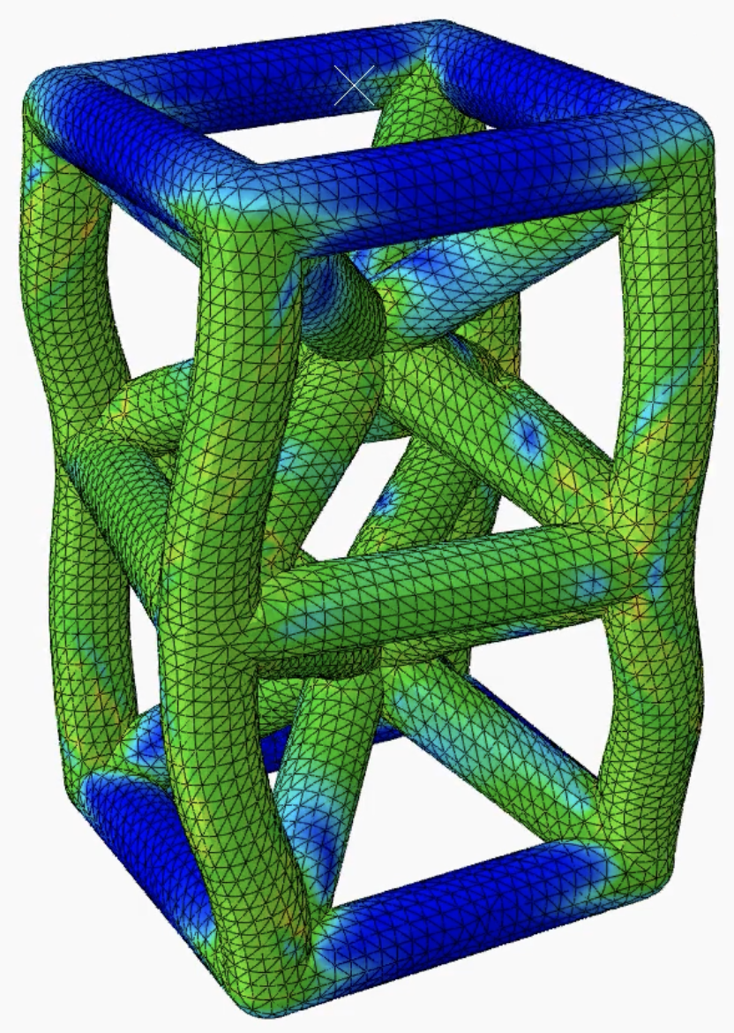
Force-Displacement Curve
For a 1x2x1 SC-BCC Column
With ABAQUS and Python Graphing
Presented By: Alec Perkins
working under Dr. Patrick Ziemke

Slide 2
Contents
01
04
Units and Material
Step and Tracked Data
02
05
Parts and Assembly
Mesh and Job
03
06
Boundary Conditions
Results

Slide 3
Units and Material
Units Used:
Mass: kg Length: Millimeters Stress: MPa - Newton*m-2 Force: Newtons Time: Seconds
Intended Units
Material Property:
Titanium Ti-6Al-4V (Grade 5), Annealed:
Data Used:
Density: 4.43e-6 kg*mm-3 Elastic: Youngs = 113.8e3 MPa, 0.342 Plastic: Yield = 880 MPa, Plastic Strain = 0, Ultimate = 950 MPa, Ultimate Strain = 0.14
Material - Titanium Ti-6Al-4V

Slide 4
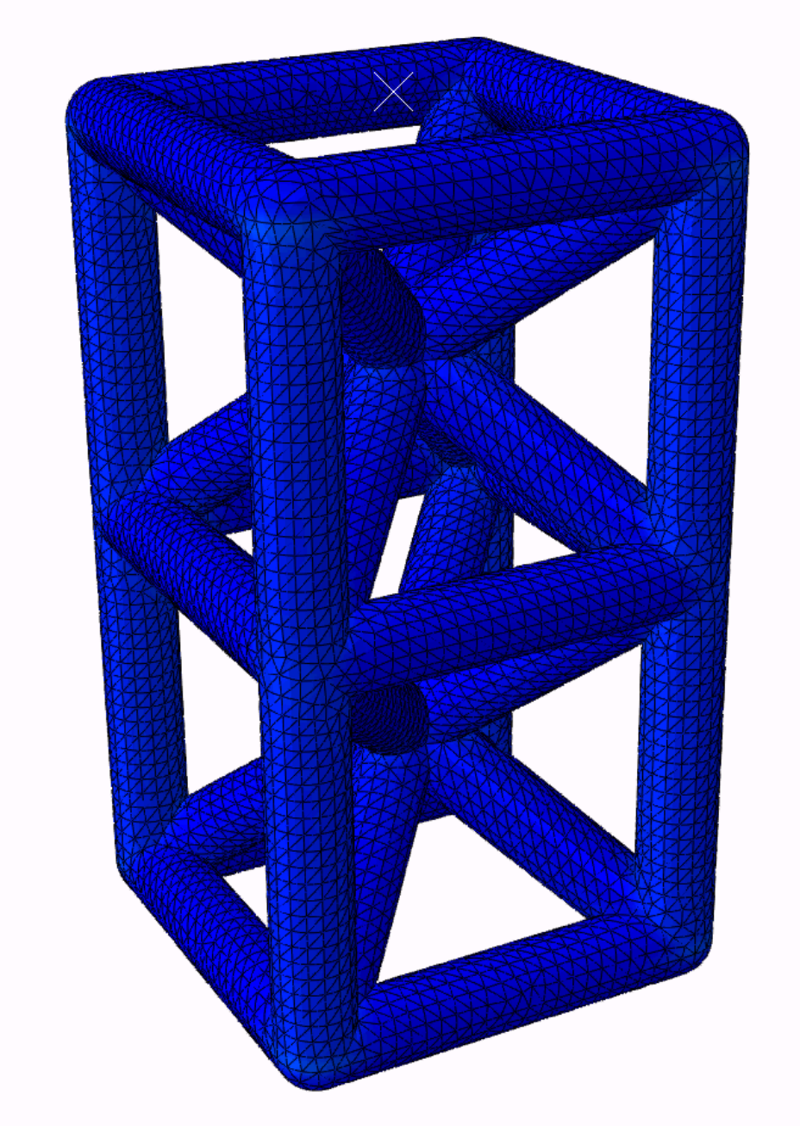
Parts and Assembly
Simple Cubic Body Centered Cubic, Unit Cell:
Strut Part Dimension Lengths:
Horizontal Strut Lengths: 100mm
Total Diagonal Strut Length: 173.21mm
Strut Radius: 10mm
Rounded Corner Part:
Sphere Diameter: 10mm
Part Descriptions
Assembly Instructions:
Linear Pattern horizontal and vertical struts
Rotate Diagonal Strut about the vertical axis
Translate Sphere Part to one corner coincident with a horizontal strut end center
Linear Pattern Sphere Part to all corners of unit cell
Merge all Instances into one SCBCC Unit Cell Part
Linear Pattern and Merge the new SCBCC Unit Cell into a 1x2x1 Column Part
SCBCC 1 x 2 Column Assembly

Slide 5
Boundary Conditions
Boundary Conditions:
Displacement applied to top center RP with B.C. for top surface
Top Center RP at (50, 200, 50)
Fixed Base in all translational and rotational directions
Fixed Top in directions U1, U2
BCs and Reference Points
Displacement Constraint:
Apply displacement to Top Center RP and Rigid Body Tie Constraint to the top surface set
Ensure the BC applied allow the top surface of the column to move rigidly with the Top Center RP compression displacement
Constraints

Slide 6
Step and Tracked Data
Step Parameters:
Loading Step: Static, general
Non-linear geometry
10,000 increments, 0.01s initial, 1e-8s smallest, 0.1s max
Time and Displacement Step
History
History Output:
At load RP set: RF1, RF2, RF3, U1, U2, U3

Slide 7
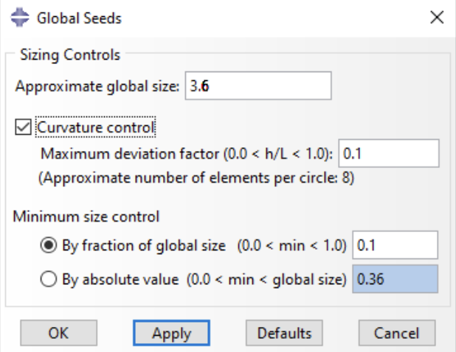
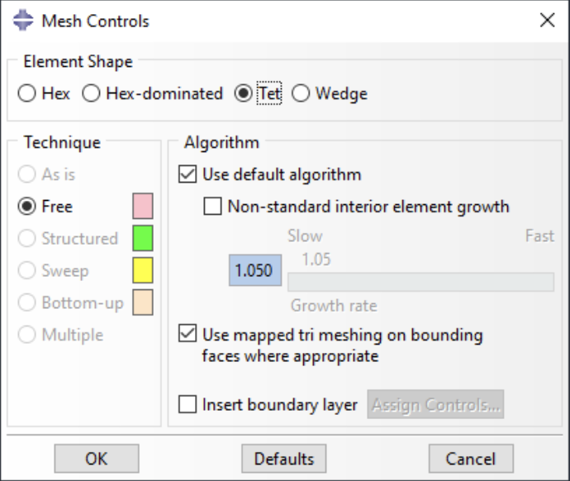
Mesh and Job
Meshing and Seeding
Create a Job for a 30mm Vertical Displacement:
Relocate as many processors that are available to run the Simulation (duration can vary depending on processor allocation)
Monitor job for distortion errors or nonlinear warnings
Creating the Job

Slide 8
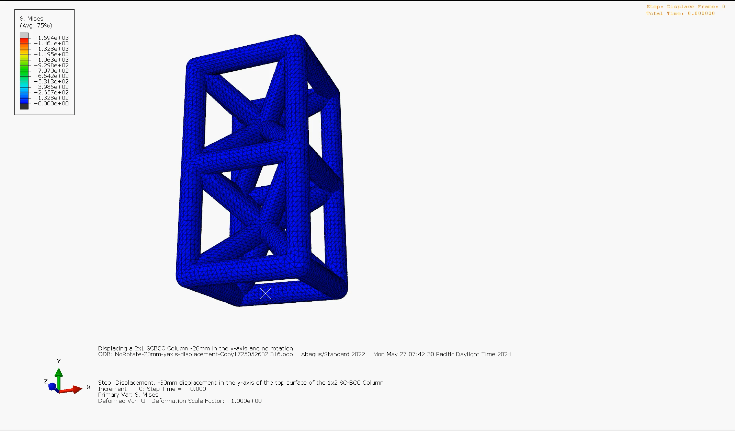
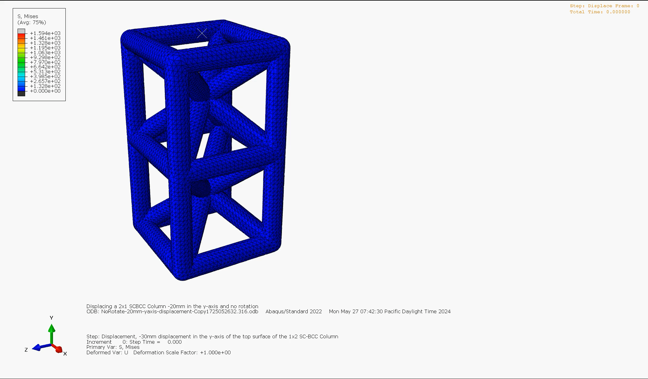
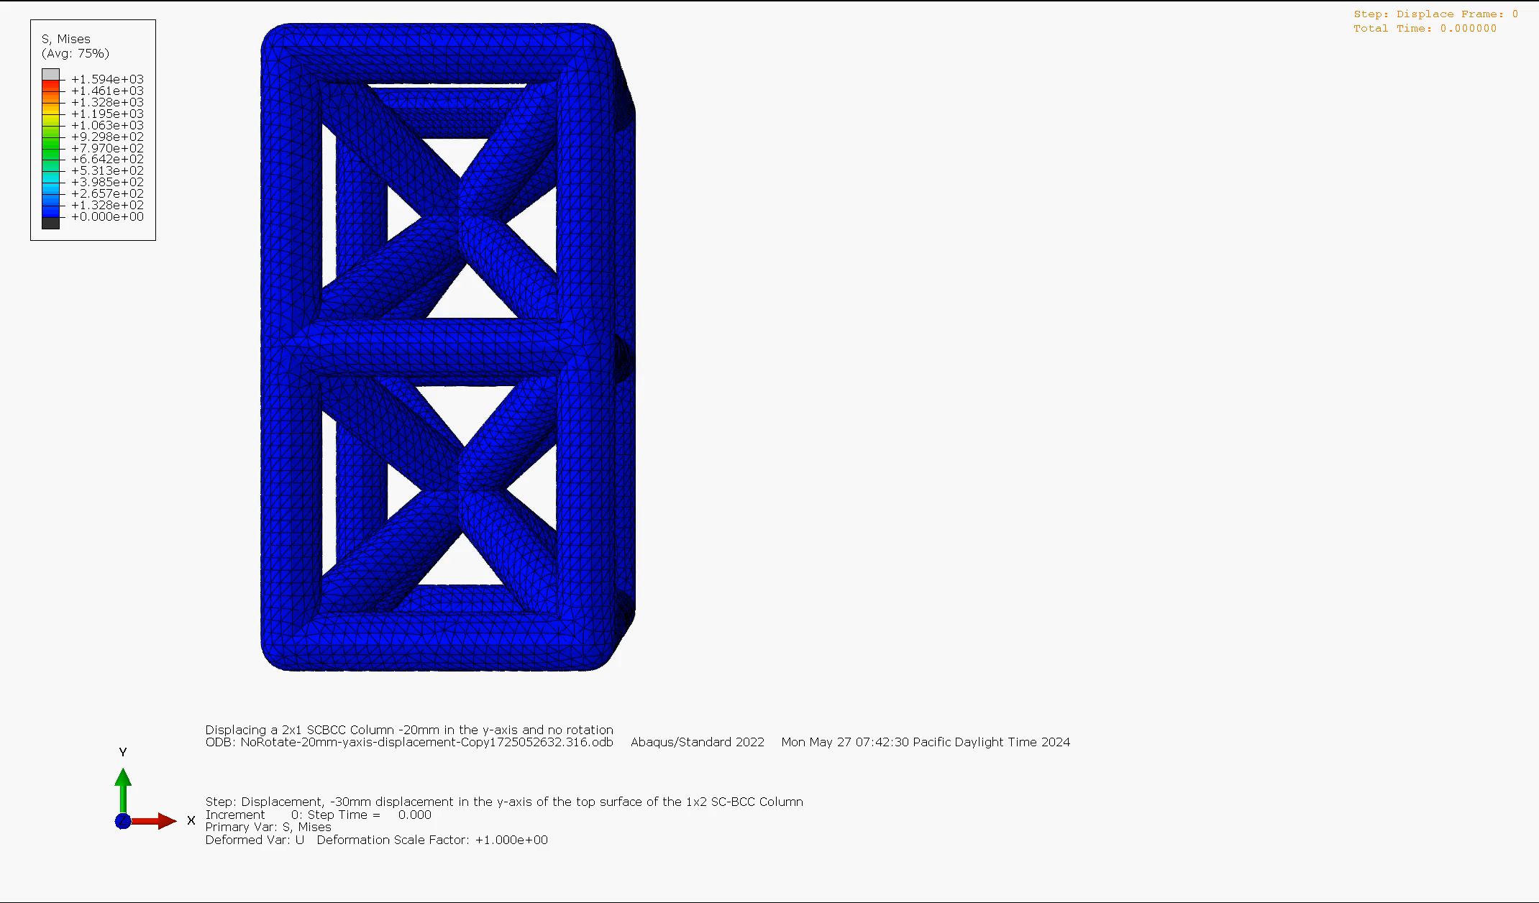
Results
Watch Videos of 30mm Displacement Results:
Bottom ISO View
Top ISO View
XY- Plane Perspective

Slide 9

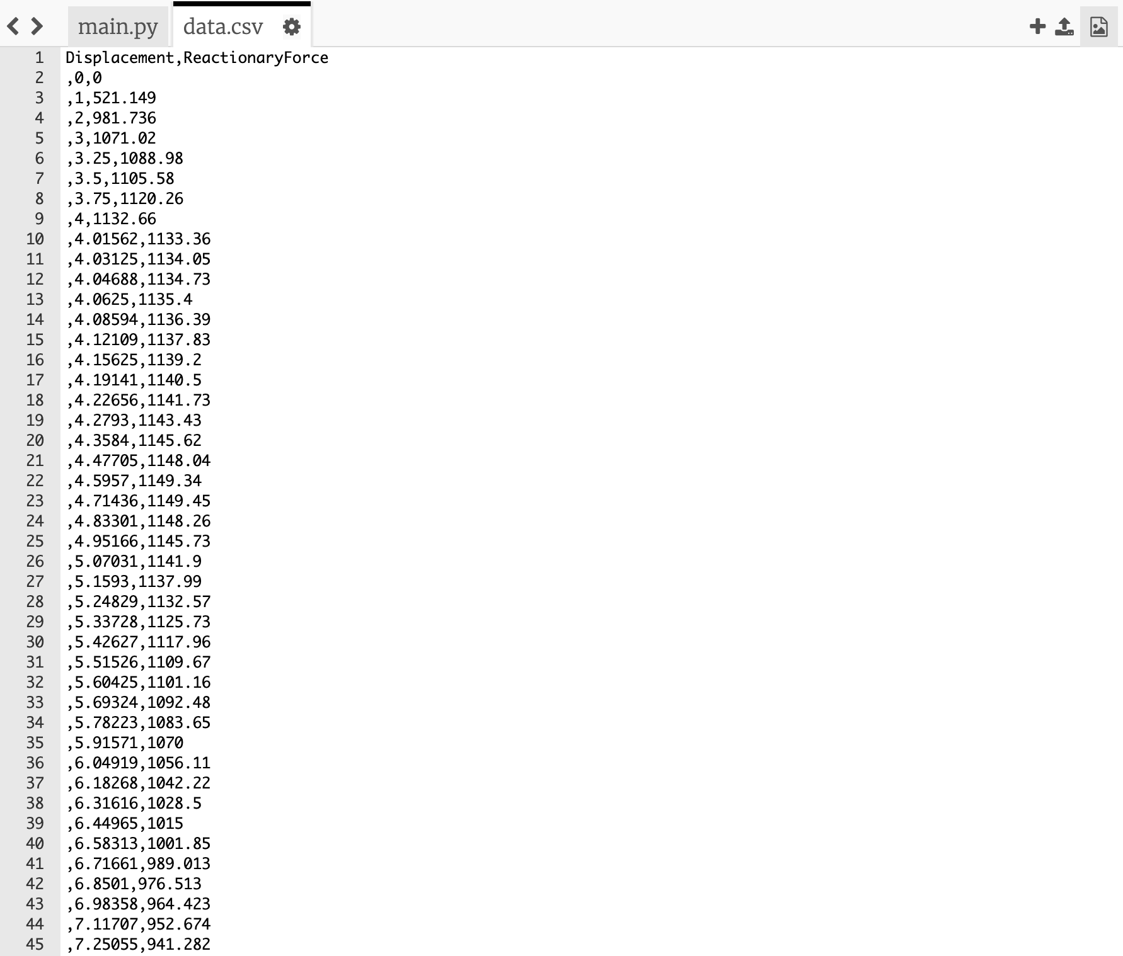

Example Reactionary Force vs. Displacement Data:

Slide 10
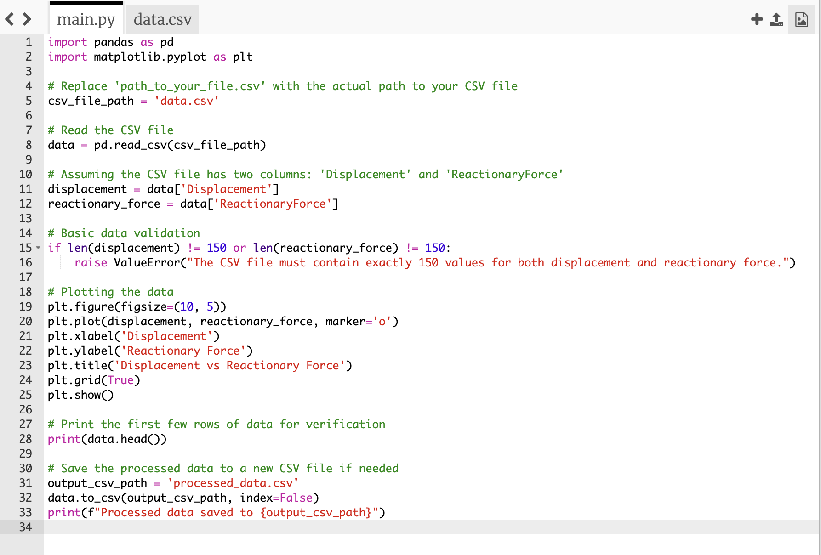
Plot Data for Reactionary Force vs. Displacement with Python:

Slide 11
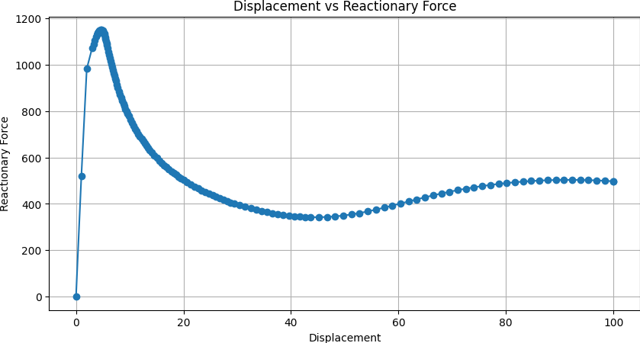
Resulting Graph
Reactionary Force vs Displacement Graph

Slide 12
Credits
Thank you for your time!
Contact the following Email with any questions:
AlecPerkins@UCSB.edu

